Slide 1
House Price Prediction Using Neural Network
Multimedia Signal Processing for Autonomous System 2023/24
Professor: Lucio Marcenaro
Student Name: Musab Mustafa Wahbi Mohamedali
Matricula s5606713

Slide 2
Introduction
Importance
Predicting house prices is essential for the real estate industry, as it aids in property valuation and investment decisions.
It enhances the user experience for buyers and sellers by providing accurate and timely market information.
Automatic price prediction helps in managing and assessing property values for real estate agencies and platforms.
Overview
This project aims to predict house prices using neural networks.
Neural networks are ideal for this task because of their capability to learn complex patterns and relationships within data.
The model is trained on a dataset of house features, with each house labeled by its corresponding price.

Slide 3
Project Objectives
Main Objective:
Develop a neural network model to predict house prices.
Secondary Goals:
Gain an understanding of data preprocessing techniques specific to housing data.
Implement and train a neural network model, such as a Multilayer Perceptron (MLP) Neural Network for tabular data.
Assess the model's performance using a validation or test dataset.

Slide 4
Dataset
Dataset: House Prices of Boston, USA Dataset
Description: Contains 1,460 Houses, with different 53 features.
Features : Zoning, street, square feet, shape, utilities, Style, house condition, construction date, roof, basement, Heating, Central air conditioning, Electrical system, bathrooms bedroom..etc.

Slide 5
Installation
Dependencies:
Python
NumPy
Pandas
Scikit-learn
PyTorch
Matplotlib
Joblib

Slide 6
Data Preprocessing
Key Points:
Load dataset: Handles loading of csv features files using pandas and NumPy.
Preprocess data: Normalizes the data (numbers and words).
Feature Engineering: Extracts the features and drop the target column to capture more complex relationships in the data.
Split data: Splits the dataset into training and test sets.
House Price Dataset: A custom dataset class for PyTorch to load and manage house price data efficiently.
prepare dataset: Combines all steps, loading the data, preprocessing, feature engineering, and splitting into train and test datasets.

Slide 7
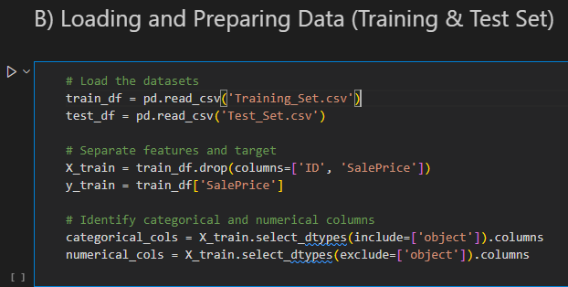
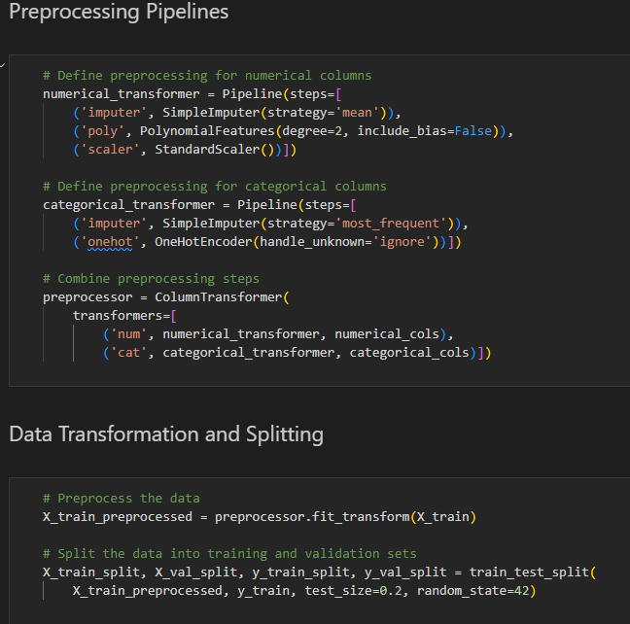
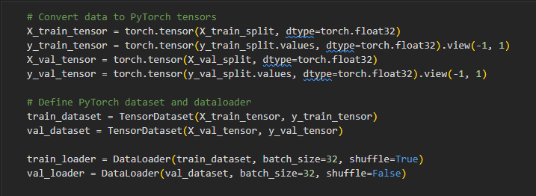
Explanation:
Effective data preprocessing is crucial for building a robust and accurate house price prediction model. The preprocessing steps transform raw property data into a structured format that can be efficiently used by the neural network for training and evaluation. This process includes handling missing values, encoding categorical variables, normalizing numerical features, and extracting relevant features, all of which are essential for improving the model's performance and accuracy.

Slide 8
System Model
Model Architecture:
The model is designed as a fully connected neural network with multiple layers to predict house prices.
It consists of five layers with progressively decreasing numbers of neurons, starting with 512 neurons in the first layer and ending with 1 neuron in the output layer.
Key Components:
Input Layer: Takes the input features, corresponding to various property characteristics.
Hidden Layers: Includes four hidden layers with 512, 256, 128, and 64 neurons, respectively. Each layer applies ReLU (Rectified Linear Unit) activation to introduce non-linearity, Batch Normalization for faster convergence and better stability, and Dropout for regularization to prevent overfitting.
Output Layer: A single neuron with a linear activation function to predict the continuous target variable, i.e., the house price.
Regularization:
L2 regularization is applied implicitly through Dropout layers, helping to reduce overfitting by randomly setting a fraction of the neurons to zero during training.

Slide 9
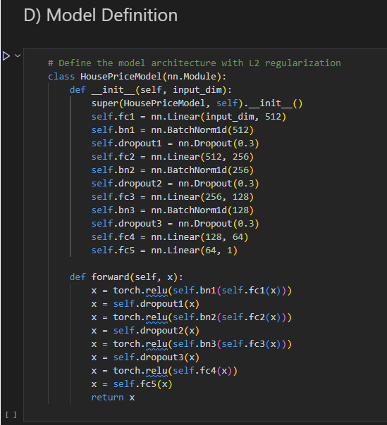
This model aims to capture complex relationships between the input features and the target house prices, leveraging deep learning techniques for accurate predictions.

Slide 10
Model Training
Prepare Dataset: Load and preprocess housing data, including normalization, encoding categorical variables, and handling missing values.
Train Model: Train the neural network model, which could be a Multilayer Perceptron (MLP) or another architecture, on the preprocessed training dataset.
Save Model: Save the trained model to a file for future predictions and analysis.
Key Points
The model is trained using the Adam optimizer, which is chosen for its efficiency in handling large and complex datasets, and the Mean Squared Error (MSE) loss function, suitable for regression tasks.
Training involves multiple epochs, iteratively adjusting the model parameters to minimize the loss and improve prediction accuracy.
The training process includes monitoring key metrics such as loss to evaluate the model's performance and convergence.

Slide 11
Thank You

